Slide 1
Whirlwind Introduction to Open-Source Analytic Tools
Anthony Sena, Adam Black & Martijn Schuemie
6 July 2025

Slide 2
Disclaimer
Anthony and Martijn are employees and shareholders of Johnson & Johnson

Slide 3
Goal for today
The goal for today is to provide a high-level overview of the Health-Analytics Data to Evidence Suite (HADES) and related tools.
We do not have the time to teach you how to use all these tools today. But all the packages have extensive documentation, and there is the Book of OHDSI (2nd edition is coming soon!).

Slide 4
HADES design principles

Slide 5
Why convert to the Common Data Model?
Transforming data to the OMOP CDM is a large investment
The benefits come from being able to use the same tools and analytics across many databases
ETL: different for everyone
Analytics: standardized and re-usable
Patient-level data in source system/schema
Patient-level data in CDM
Reliable evidence

Slide 6











OMOP CDM Database Support
Amazon Redshift,
Azure DataBricks
Azure Synapse
DuckDB
Google BigQuery
InterSystems IRIS
Microsoft SQL Server
Oracle
PostgreSQL
Snowflake
SQLite

Slide 7
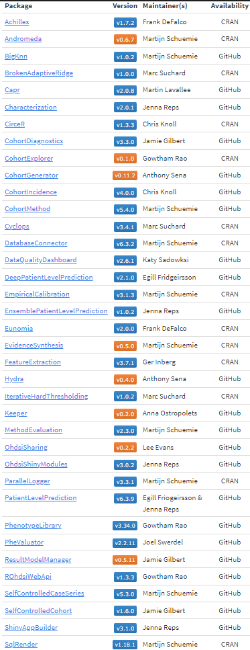



What is HADES?
Collection of open-source R packages used in almost every OHDSI study
Run directly against data in the OMOP Common Data Model (CDM)
Cutting edge analytics and visualizations
https://ohdsi.github.io/Hades/

Slide 8
HADES design principles
Open-source software
Code validation & unit tests
Driven by methods research
State-of-the-art methods
Empirically shown to work
Encourage use of best practices (e.g. large-scale propensity scores)
Allow for evaluation of assumptions
E.g. by using negative controls
Large-scale analytics
E.g. many exposures and outcomes in one study
Platform independent

Slide 9
HADES R packages
41 packages so far. Some important ones
Characterization
Characterization
CohortIncidence
TreatmentPatterns
Estimation
CohortMethod
SelfControlledCaseSeries
EvidenceSynthesis
Prediction
PatientLevelPrediction
Cohorts
CohortGenerator
CohortDiagnostics
Capr
Support
ROhdsiWebApi
DatabaseConnector + SqlRender*
Cyclops
ParallelLogger
FeatureExtraction
Andromeda
Strategus*

Slide 10
DatabaseConnector + SqlRender
Goal: write SQL code once, run on all supported platforms
Emulate temp tables for platforms that don’t have them
Translates `OhdsiSql` into the desired SQL dialect
OhdsiSql is a subset of SQL Server SQL
Separate syntax for parameterization of SQL
OhdsiSql | SqlServer | PostgreSQL
SELECT TOP 10 person_id FROM @cdm.person; | SELECT TOP 10 person_id FROM my_cdm.person; | SELECT person_id FROM my_cdm.person LIMIT 10;

Slide 11

Strategus
Goal: Design and coordinate execution of HADES packages for studies.
Design principles for Strategus:
All study design choices are captured in an analysis specification: an open, machine-readable document (JSON)
R execution environment fully specified using renv providing transparency and reproducibility
Patient level data never leaves the site
All aggregate results are in an open format (csv) to allow inspection
Supports HADES packages for managing and viewing results across sites via Rshiny (OhdsiShinyAppBuilder/OhdsiShinyModules)
Patient Level Prediction
Self Controlled Case Series
CohortMethod
Characterization
Cohort Incidence
Cohort Diagnostics
Cohort Generator

Slide 12


Distributed Research Network
Multiple sites with data
Hospital EHRs (Electronic Health Records)
Administrative Claims
Patient-level data cannot be shared
Each site uses the Common Data Model (CDM)
Site A
Site B
CDM
CDM
Site C
Site D
CDM
CDM

Slide 13
Distributed Research Network
A site can lead a study
Study lead
Site A
Site B
CDM
CDM
Site C
Site D
CDM
CDM

Slide 14

Distributed Research Network
A site can lead a study
Analysis code is developed locally
Study lead
Site A
Site B
CDM
CDM
Site C
Site D
CDM
CDM

Slide 15
Distributed Research Network
A site can lead a study
Analysis code is developed locally
Code is distributed to study participants
Study lead
Site A
Site B
CDM
CDM
Site C
Site D
CDM
CDM

Slide 16

Distributed Research Network
A site can lead a study
Analysis code is developed locally
Code is distributed to study participants
Results are generated (aggregated statistics)
Study lead
Site A
Site B
CDM
CDM
Site C
Site D
CDM
CDM

Slide 17
Distributed Research Network
A site can lead a study
Analysis code is developed locally
Code is distributed to study participants
Results are generated (aggregated statistics)
Results are sent back to lead site
Study lead
Site A
Site B
CDM
CDM
Site C
Site D
CDM
CDM

Slide 18
Distributed Research Network
A site can lead a study
Analysis code is developed locally
Code is distributed to study participants
Results are generated (aggregated statistics)
Results are sent back to lead site
Evidence is synthesized
Study lead
Site A
Site B
CDM
CDM
Site C
Site D
CDM
CDM

Slide 19

Strategus for study execution
Firewall
Cohort definitions
Strategus
CSV files
CSV files
Analysis specifications
Analysis specifications
Characterization specifications
CohortMethod specifications
Results database
Execution settings
SCCS specifications
Connection details, etc.
PatientLevel-Prediction specifications

Slide 20
Tour of HADES Analytics

Slide 21
Analytic use case | Type | Structure
Clinical characterization | Disease Natural History | Amongst patients who are diagnosed with <insert your favorite disease>, what are the patient’s characteristics from their medical history?
 | Treatment utilization | Amongst patients who have <insert your favorite disease>, which treatments were patients exposed to amongst <list of treatments for disease> and in which sequence?
 | Outcome incidence | Amongst patients who are new users of <insert your favorite drug>, how many patients experienced <insert your favorite known adverse event from the drug profile> within <time horizon following exposure start>?
Population-level effect estimation | Safety surveillance | Does exposure to <insert your favorite drug> increase the risk of experiencing <insert an adverse event> within <time horizon following exposure start>?
 | Comparative effectiveness | Does exposure to <insert your favorite drug> have a different risk of experiencing <insert any outcome (safety or benefit) > within <time horizon following exposure start>, relative to <insert your comparator treatment>?
Patient level prediction | Disease onset and progression | For a given patient who is diagnosed with <insert your favorite disease>, what is the probability that they will go on to have <another disease or related complication> within <time horizon from diagnosis>?
 | Treatment response | For a given patient who is a new user of <insert your favorite chronically-used drug>, what is the probability that they will <insert desired effect> in <time window>?
 | Treatment safety | For a given patient who is a new user of <insert your favorite drug>, what is the probability that they will experience <insert adverse event> within <time horizon following exposure>?

Slide 22
Analytic use case | Type | Structure
Clinical characterization | Disease Natural History | Amongst patients who are diagnosed with <insert your favorite disease>, what are the patient’s characteristics from their medical history?
 | Treatment utilization | Amongst patients who have <insert your favorite disease>, which treatments were patients exposed to amongst <list of treatments for disease> and in which sequence?
 | Outcome incidence | Amongst patients who are new users of <insert your favorite drug>, how many patients experienced <insert your favorite known adverse event from the drug profile> within <time horizon following exposure start>?
Population-level effect estimation | Safety surveillance | Does exposure to <insert your favorite drug> increase the risk of experiencing <insert an adverse event> within <time horizon following exposure start>?
 | Comparative effectiveness | Does exposure to <insert your favorite drug> have a different risk of experiencing <insert any outcome (safety or benefit) > within <time horizon following exposure start>, relative to <insert your comparator treatment>?
Patient level prediction | Disease onset and progression | For a given patient who is diagnosed with <insert your favorite disease>, what is the probability that they will go on to have <another disease or related complication> within <time horizon from diagnosis>?
 | Treatment response | For a given patient who is a new user of <insert your favorite chronically-used drug>, what is the probability that they will <insert desired effect> in <time window>?
 | Treatment safety | For a given patient who is a new user of <insert your favorite drug>, what is the probability that they will experience <insert adverse event> within <time horizon following exposure>?
Standardizing the question itself helps clarify what your objective is

Slide 23
Analytic use case | Type | Structure
Clinical characterization | Disease Natural History | Amongst patients who are diagnosed with <insert your favorite disease>, what are the patient’s characteristics from their medical history?
 | Treatment utilization | Amongst patients who have <insert your favorite disease>, which treatments were patients exposed to amongst <list of treatments for disease> and in which sequence?
 | Outcome incidence | Amongst patients who are new users of <insert your favorite drug>, how many patients experienced <insert your favorite known adverse event from the drug profile> within <time horizon following exposure start>?
Population-level effect estimation | Safety surveillance | Does exposure to <insert your favorite drug> increase the risk of experiencing <insert an adverse event> within <time horizon following exposure start>?
 | Comparative effectiveness | Does exposure to <insert your favorite drug> have a different risk of experiencing <insert any outcome (safety or benefit) > within <time horizon following exposure start>, relative to <insert your comparator treatment>?
Patient level prediction | Disease onset and progression | For a given patient who is diagnosed with <insert your favorite disease>, what is the probability that they will go on to have <another disease or related complication> within <time horizon from diagnosis>?
 | Treatment response | For a given patient who is a new user of <insert your favorite chronically-used drug>, what is the probability that they will <insert desired effect> in <time window>?
 | Treatment safety | For a given patient who is a new user of <insert your favorite drug>, what is the probability that they will experience <insert adverse event> within <time horizon following exposure>?

Slide 24
Analytic use case | Type | Structure
Clinical characterization | Disease Natural History | Amongst patients who are diagnosed with <insert your favorite disease>, what are the patient’s characteristics from their medical history?
 | Treatment utilization | Amongst patients who have <insert your favorite disease>, which treatments were patients exposed to amongst <list of treatments for disease> and in which sequence?
 | Outcome incidence | Amongst patients who are new users of <insert your favorite drug>, how many patients experienced <insert your favorite known adverse event from the drug profile> within <time horizon following exposure start>?
Population-level effect estimation | Safety surveillance | Does exposure to <insert your favorite drug> increase the risk of experiencing <insert an adverse event> within <time horizon following exposure start>?
 | Comparative effectiveness | Does exposure to <insert your favorite drug> have a different risk of experiencing <insert any outcome (safety or benefit) > within <time horizon following exposure start>, relative to <insert your comparator treatment>?
Patient level prediction | Disease onset and progression | For a given patient who is diagnosed with <insert your favorite disease>, what is the probability that they will go on to have <another disease or related complication> within <time horizon from diagnosis>?
 | Treatment response | For a given patient who is a new user of <insert your favorite chronically-used drug>, what is the probability that they will <insert desired effect> in <time window>?
 | Treatment safety | For a given patient who is a new user of <insert your favorite drug>, what is the probability that they will experience <insert adverse event> within <time horizon following exposure>?
Amongst patients who are new users of GLP-1s, how many patients experienced Acute Myocardial Infarction within drug exposure?

Slide 25
Analytic use case | Type | Structure
Clinical characterization | Disease Natural History | Amongst patients who are diagnosed with <insert your favorite disease>, what are the patient’s characteristics from their medical history?
 | Treatment utilization | Amongst patients who have <insert your favorite disease>, which treatments were patients exposed to amongst <list of treatments for disease> and in which sequence?
 | Outcome incidence | Amongst patients who are new users of <insert your favorite drug>, how many patients experienced <insert your favorite known adverse event from the drug profile> within <time horizon following exposure start>?
Population-level effect estimation | Safety surveillance | Does exposure to <insert your favorite drug> increase the risk of experiencing <insert an adverse event> within <time horizon following exposure start>?
 | Comparative effectiveness | Does exposure to <insert your favorite drug> have a different risk of experiencing <insert any outcome (safety or benefit) > within <time horizon following exposure start>, relative to <insert your comparator treatment>?
Patient level prediction | Disease onset and progression | For a given patient who is diagnosed with <insert your favorite disease>, what is the probability that they will go on to have <another disease or related complication> within <time horizon from diagnosis>?
 | Treatment response | For a given patient who is a new user of <insert your favorite chronically-used drug>, what is the probability that they will <insert desired effect> in <time window>?
 | Treatment safety | For a given patient who is a new user of <insert your favorite drug>, what is the probability that they will experience <insert adverse event> within <time horizon following exposure>?
For a given patient who is a new user of GLP-1s, what is the probability that they will experience an AMI while exposed to the drug?

Slide 26
Analytic use case | Type | Structure
Clinical characterization | Disease Natural History | Amongst patients who are diagnosed with <insert your favorite disease>, what are the patient’s characteristics from their medical history?
 | Treatment utilization | Amongst patients who have <insert your favorite disease>, which treatments were patients exposed to amongst <list of treatments for disease> and in which sequence?
 | Outcome incidence | Amongst patients who are new users of <insert your favorite drug>, how many patients experienced <insert your favorite known adverse event from the drug profile> within <time horizon following exposure start>?
Population-level effect estimation | Safety surveillance | Does exposure to <insert your favorite drug> increase the risk of experiencing <insert an adverse event> within <time horizon following exposure start>?
 | Comparative effectiveness | Does exposure to <insert your favorite drug> have a different risk of experiencing <insert any outcome (safety or benefit) > within <time horizon following exposure start>, relative to <insert your comparator treatment>?
Patient level prediction | Disease onset and progression | For a given patient who is diagnosed with <insert your favorite disease>, what is the probability that they will go on to have <another disease or related complication> within <time horizon from diagnosis>?
 | Treatment response | For a given patient who is a new user of <insert your favorite chronically-used drug>, what is the probability that they will <insert desired effect> in <time window>?
 | Treatment safety | For a given patient who is a new user of <insert your favorite drug>, what is the probability that they will experience <insert adverse event> within <time horizon following exposure>?
Does exposure to GLP-1s have a different risk of experiencing AMI while exposed to drug, relative to DPP-4s?

Slide 27
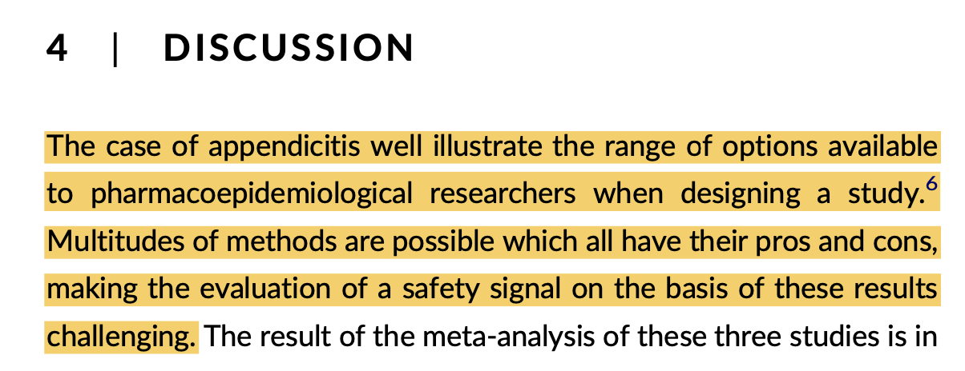

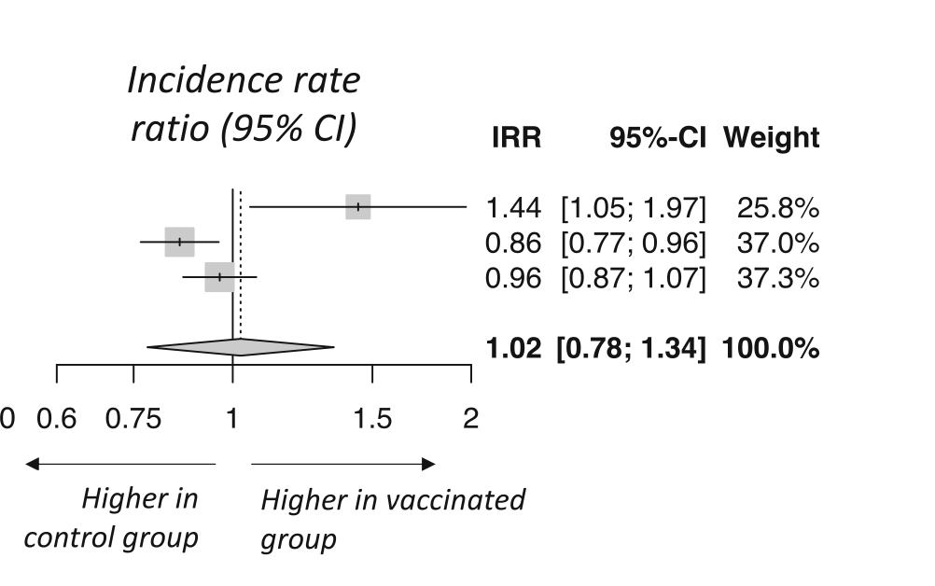
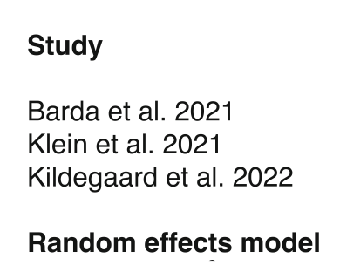
One question, three answers
"Recent studies have demonstrated that conducting hundreds or thousands of sensitivity analyses to evaluate the influence of design and analysis choices ... is becoming feasible and could be one of the future direction to appraise the robustness of pharmacoepidemiological results"

Slide 28
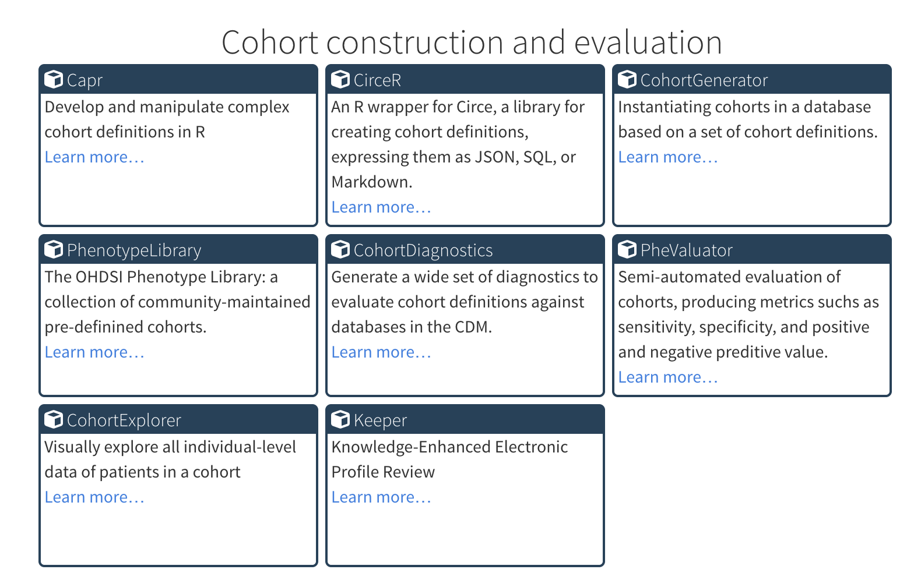
HADES Cohort packages

Slide 29
OHDSI Cohort definitions
OHDSI Cohort definitions are
the foundation of HADES analytics
transparent
reproducible
transportable
reusable

Slide 30
OHDSI Cohort definitions
A Cohort is a set of persons who satisfy one or more inclusion criteria for a duration of time.
Cohort = { (person₁, day₁), (person₁, day₂), (person₁ day₃), … (person_{i}, day_{j}) }
Consequences of this definition:
• One person may belong to multiple cohorts
• One person may belong to the same cohort at multiple different time periods
• One person may not belong to the same cohort multiple times during the same period of time
• One cohort may have zero or more members
• A codeset is NOT a cohort… logic for how to use the codeset in criteria is required

Slide 31
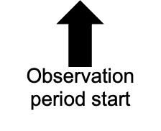
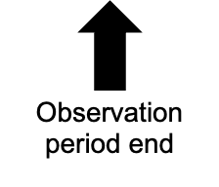
Anatomy of a cohort definition
1. What initial event(s) define cohort entry?
3. What defines a person’s cohort exit?
Index event
Cohort Exit
Person timeline
Inclusion / exclusion criteria
2. What inclusion criteria are applied to the initial events?

Slide 32
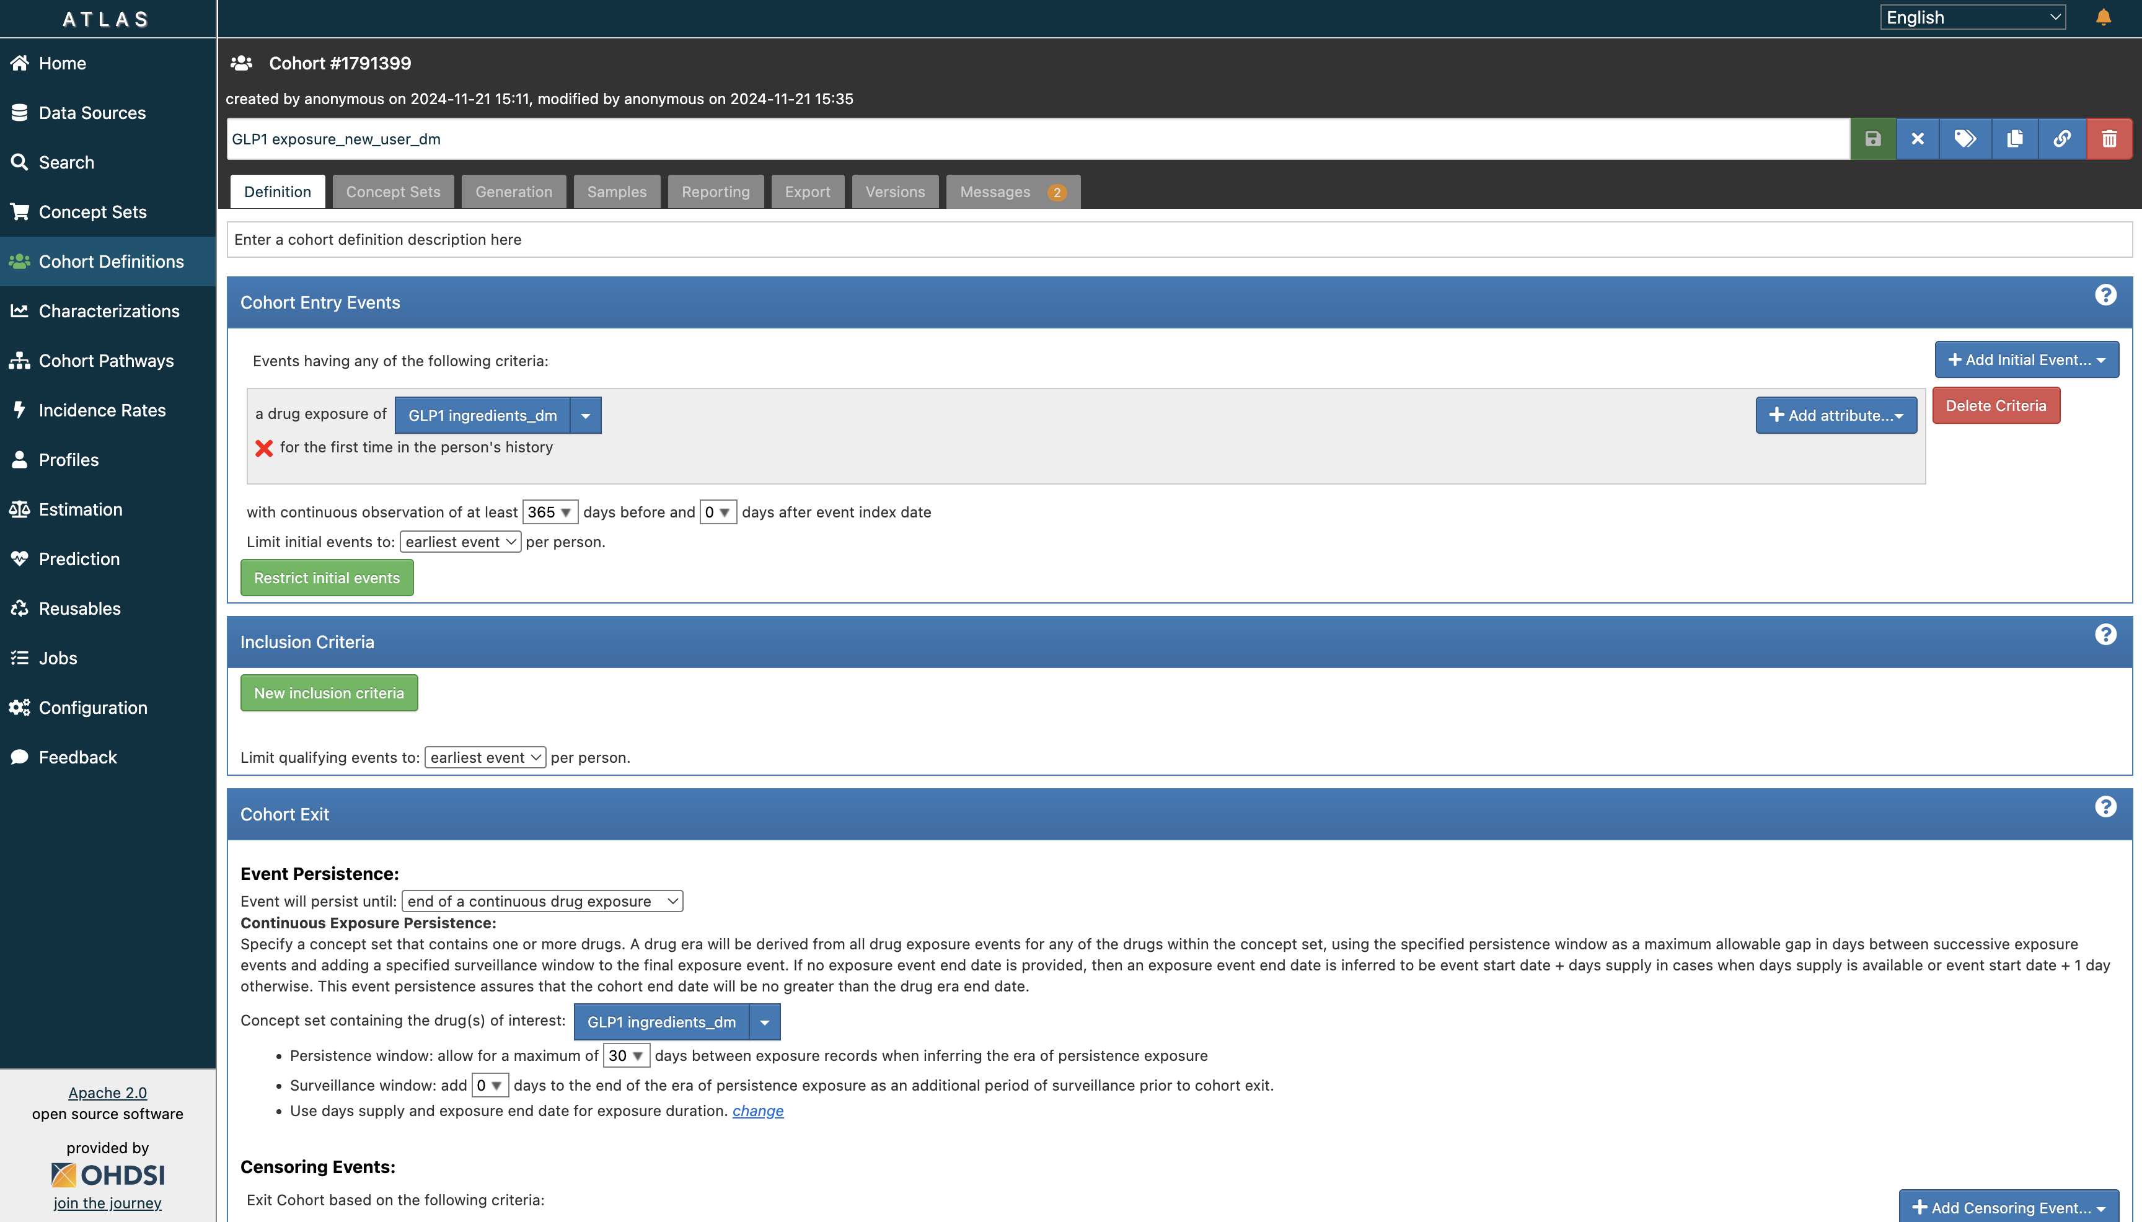
Building Cohorts with Atlas

Slide 33
Building cohorts with Capr
library(Capr)
GLP1 <- cs(descendants(93143,44506754,40170911,1583722,45774435,44816332))
GPL1CohortDefinition <- cohort(
entry = entry(drugExposure(GLP1, firstOccurrence()),
continuousObservation(priorDays = 365L),
primaryCriteriaLimit = "First"),
exit = drugExit(GLP1, persistenceWindow = 30L)
)

Slide 34
Building lots of cohorts with Capr
library(Capr)
# cohort template function
DrugEraCohortDefinition <- function(drugConceptSet) {
cohort(
entry = entry(drugExposure(drugConceptSet, firstOccurrence()),
continuousObservation(priorDays = 365L),
primaryCriteriaLimit = "First"),
exit = drugExit(drugConceptSet, persistenceWindow = 30L)
)
}
GLP1 <- cs(descendants(93143,44506754,40170911,1583722,45774435,44816332))
DrugEraCohortDefinition(drugConceptSet = GLP1)
DrugEraCohortDefinition(drugConceptSet = DPP4)

Slide 35
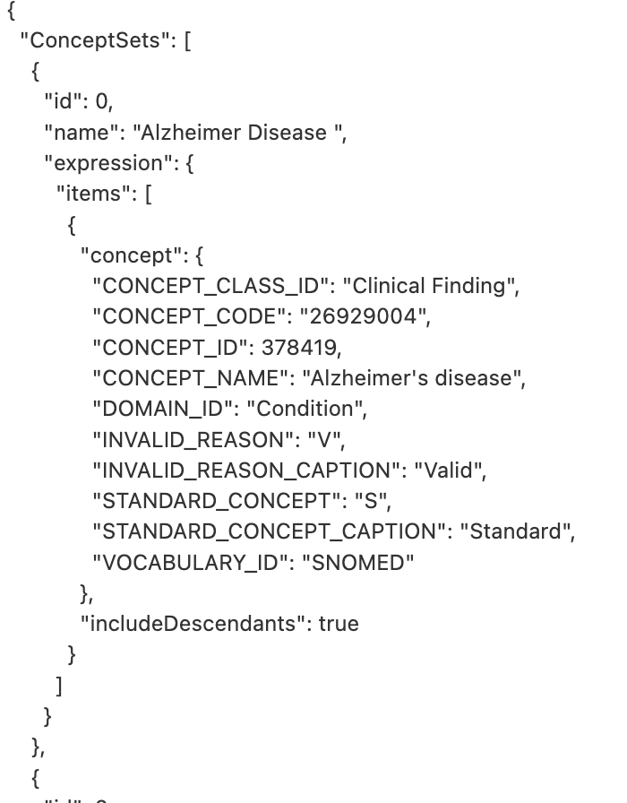
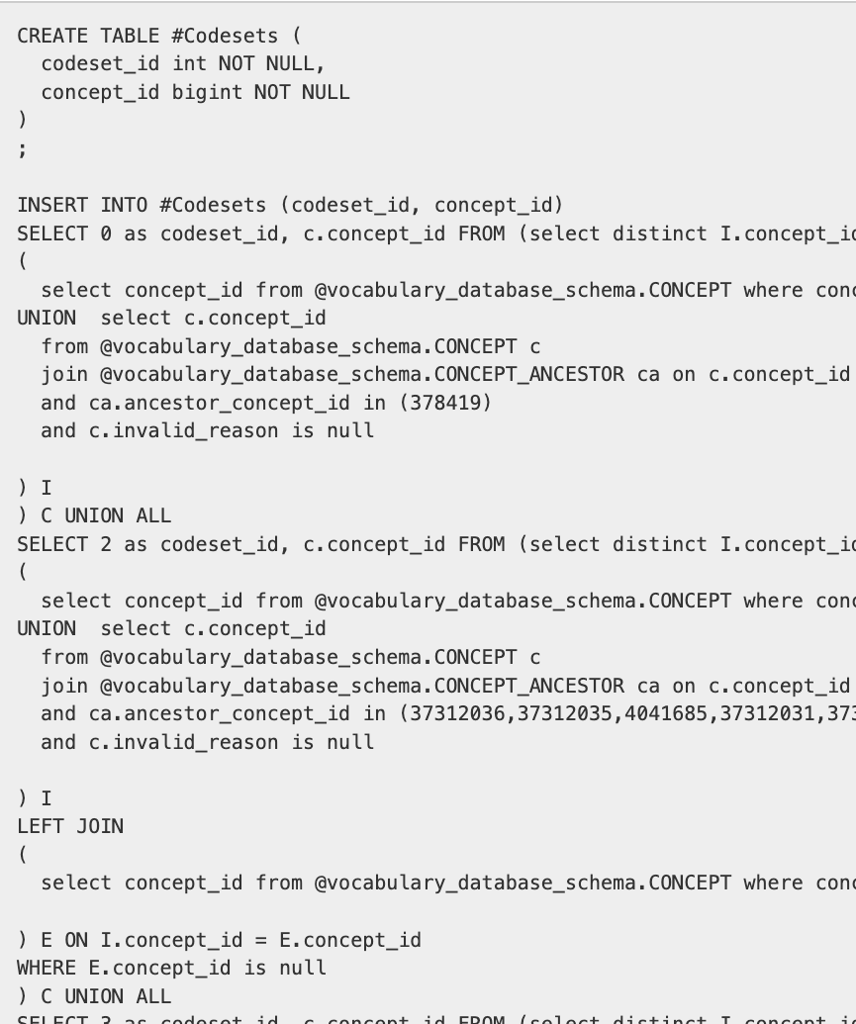


Cohort Definition
Circe
json
SQL
Atlas
Capr

Slide 36

Cohort Generation
Circe
CohortGenerator
json
SQL
CDM Database
Generated Cohort

Slide 37
CohortGenerator & ROhdsiWebApi
Options for defining cohorts
Define cohorts using ATLAS and download using ROhdsiWebApi
Use Capr to define cohorts
Generate cohorts against your CDM using CohortGenerator
Advanced topics:
Define subsets using demographics, nested by indication, etc using CohortGenerator

Slide 38
Cohorts of our examples
Indication cohorts:
Hypertension People with hypertension, while having hypertension
Exposures cohorts :
ACE Inhibitors People on ACE Inhibitors, while on the drug
Diuretic People on a diuretic, while on the drug
Outcomes cohorts :
Acute myocardial infarction (AMI) People with AMI, at the time of AMI
Angioedema People with Angioedema, while having angioedema
These same cohorts can be re-used to answer different questions

Slide 39
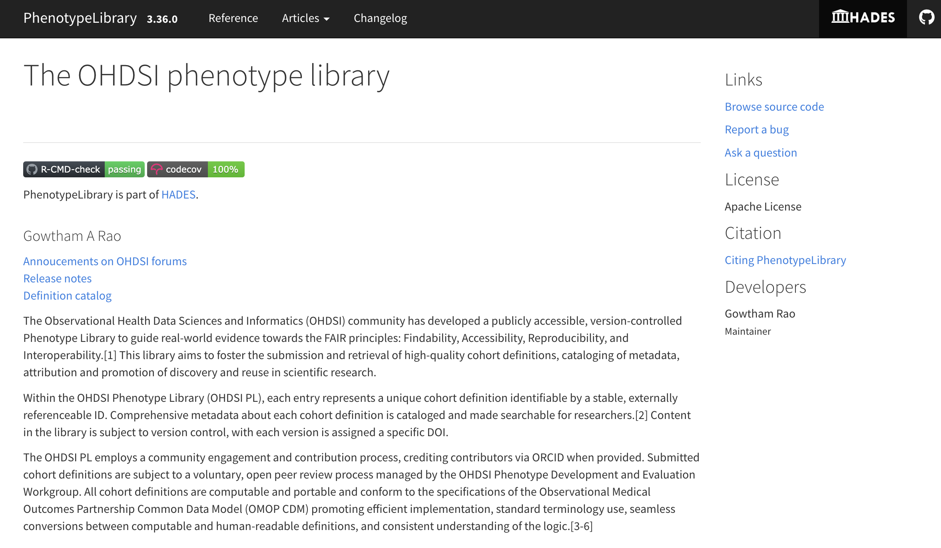
The OHDSI Phenotype Library

Slide 40
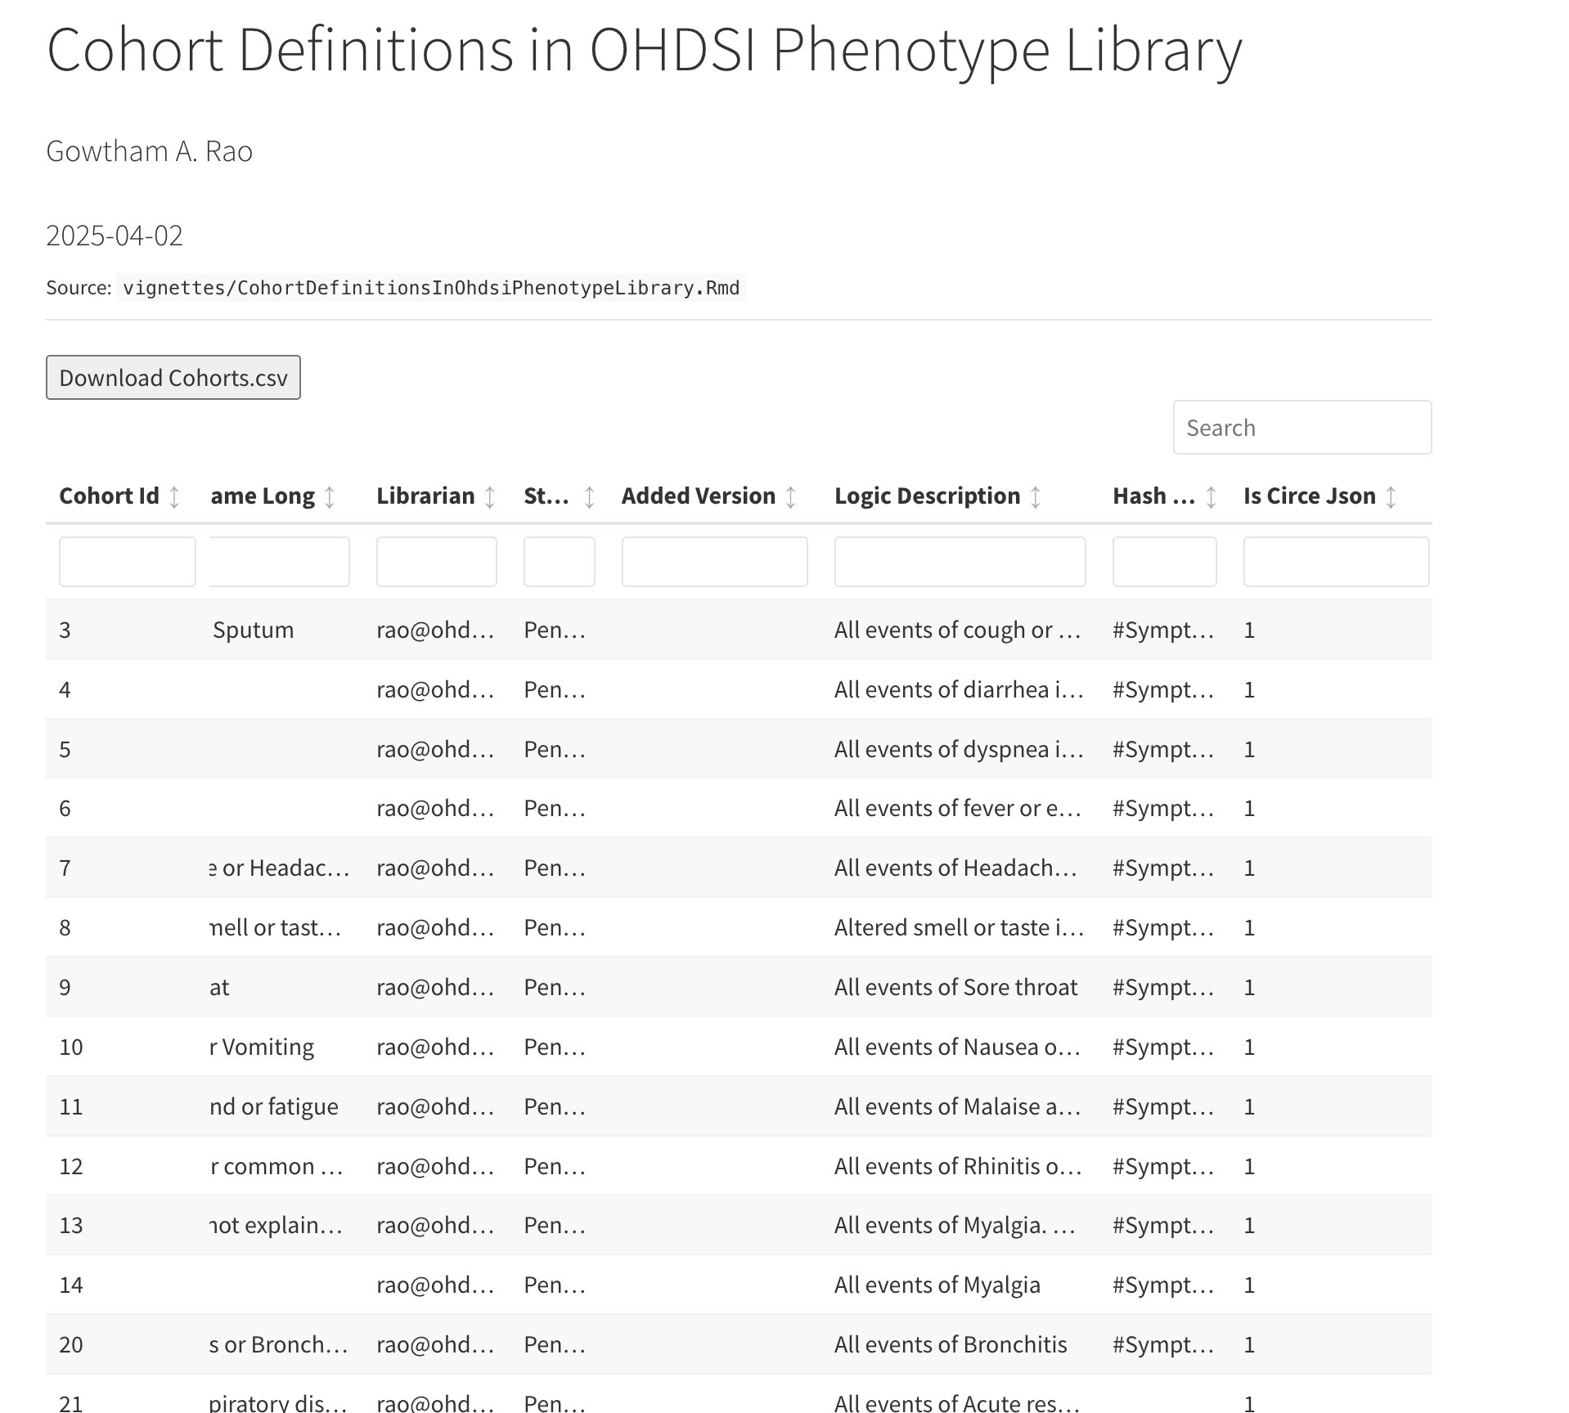
The OHDSI Phenotype Library
Globally unique cohort IDs
Peer reviewed
Clinical descriptions
Good starting point for cohort building

Slide 41
CohortDiagnostics
Provides several diagnostics on cohort definitions:
Concept set diagnostics: check sensitivity/specificity of concept sets
Cohort characterization: clinical plausibility
Incidence rates: temporal trends, identify database artifacts
Attrition: evaluate impact of each inclusion criteria
Time distributions: time in cohort, observation time prior to and after.
Cohort overlap: check if cohorts are subsets of one another
Topics to keep in mind when evaluating cohorts:
Sensitivity / Specificity tradeoff
Capture the correct index date
Incidence vs prevalent cases

Slide 42
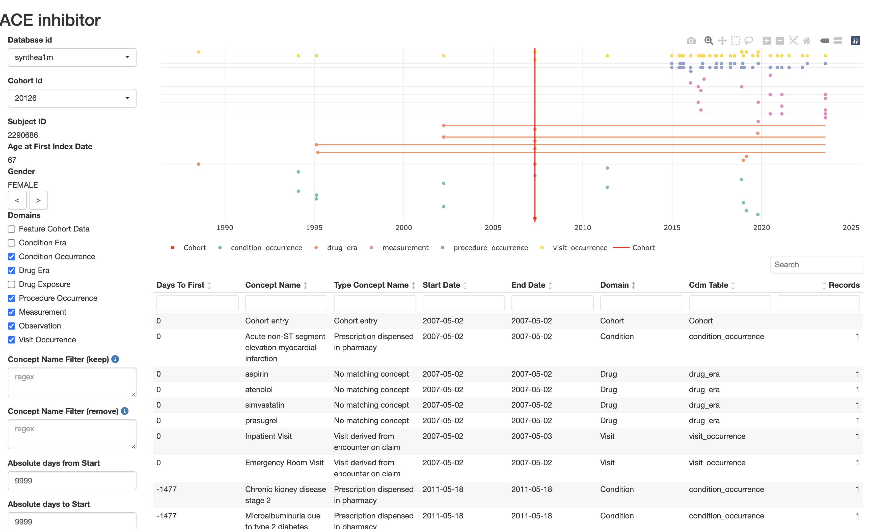
CohortExplorer

Slide 43
Cohort building examples
ACE inhibitors
ACE inhibitors nested in Hypertension
Acute myocardial infarction

Slide 44

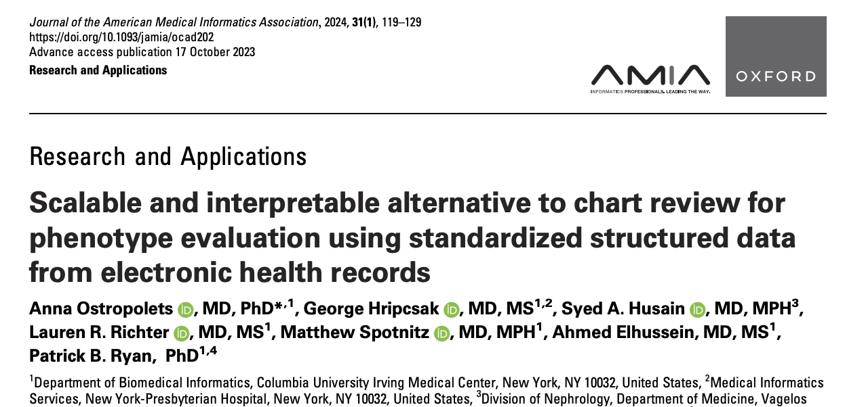
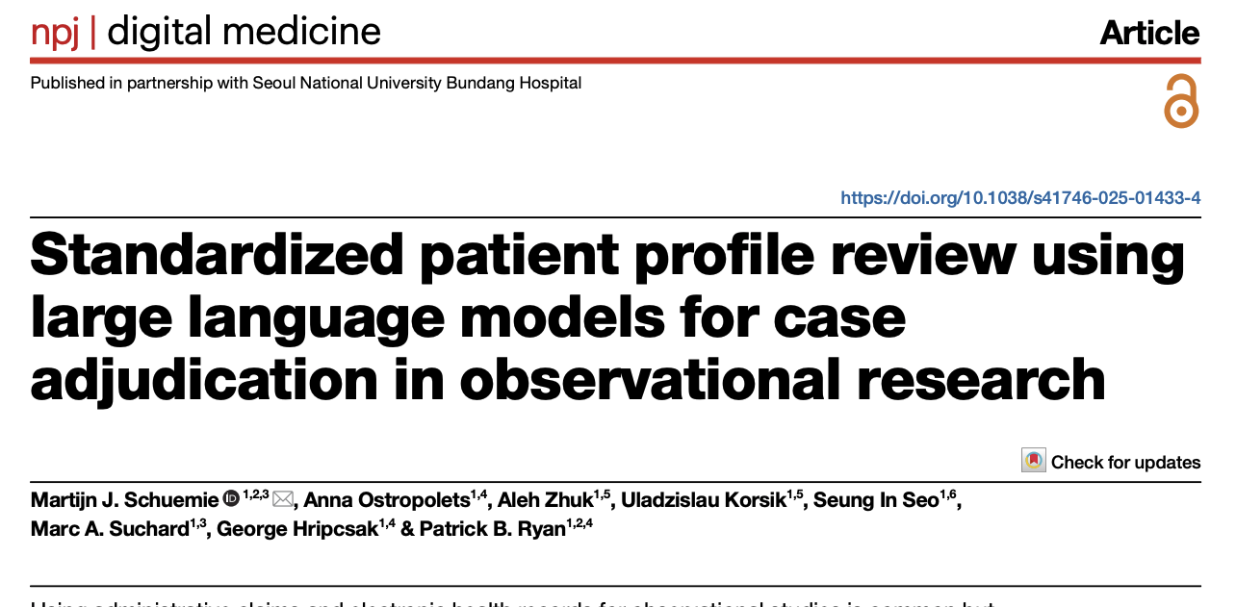
Other phenotype validation tools
PheValuator
Build a predictive model on definitely true and definitely false cases
Use model to generate annotated silver standard
Compute sensitivity and specificity
KEEPER
Define patient attributes to extract (symptoms, treatments, diagnostic procedures, alternative diagnoses, etc.)
Extract attributes per patient
Have human or LLM adjudicate patient profiles

Slide 45
Characterization: CohortIncidence package
Amongst patients who are new users of GLP-1s, how many patients experienced Acute Myocardial Infarction within drug exposure?
Target: GLP-1
Outcome: AMI
Outcome cohort
Outcome cohort
Patient 1
Target cohort
Outcome cohort
Patient 2
Target cohort
Computes the incidence rate of the Outcome cohort in some Target cohort
Standardized computation of incidence rates
Default: overall and stratified by age, sex, and calendar time

Slide 46






PatientLevelPrediction package
For a given patient who is a new user of GLP-1s, what is the probability that they will experience an AMI while exposed to the drug?
Target: GLP-1, restricted to those with T2DM (and first use only)
Outcome: AMI
Outcome cohort
Patient 1
Target cohort
Patient 2
Target cohort
Builds a model to predict who in the Target will have the Outcome
Uses all observed data up to Target start
Implements many machine learning / deep learning algorithms

Slide 47
Unique feature: external validation
When using the PatientLevelPrediction package, models fit in one database can easily be validated in other databases
Portability of code
Standardized construction of features

Slide 48
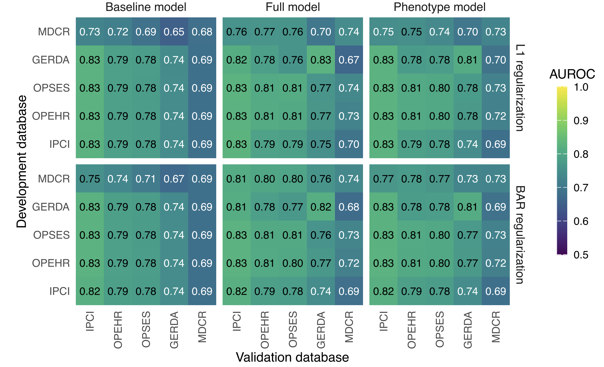
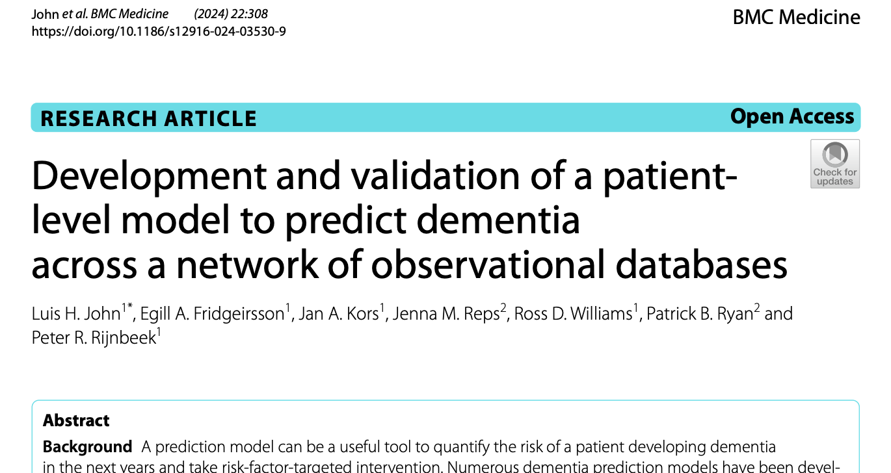
Example of external validation

Slide 49
CohortMethod package
Does exposure to GLP-1s have a different risk of experiencing AMI while exposed to drug, relative to DPP-4s?
Target: GLP-1, restricted to those with T2DM (and first use only)
Comparator: DPP-4, restricted to those with T2DM (and first use only)
Outcome: AMI
Outcome cohort
Patient 1
Target cohort
Outcome cohort
Patient 2
Comparator cohort
Computes the hazard of the Outcome cohort in the Target cohort compared to the Comparator

Slide 50
Unique feature: Large-scale propensity scores
Treatment assignment is often non-random, which can cause confounding
E.g. GLP-1 may be prescribed more often to obese, who already have a higher risk of AMI
Propensity scores are an establish way to address this
Fit a model to predict treatment assignment, and use to compute probability (propensity score)
Match subjects in Target to Comparator with similar propensity scores
Traditionally, expert pick a few variables to use in the prediction model
Large-scale propensity scores include all baseline covariates, and uses machine learning

Slide 51
Unique feature: objective diagnostics
Whether study results are reliable depends on whether certain assumptions have been met
E.g. we assume our PS adjustment makes our treatment groups comparable
Most of these assumptions are testable through diagnostics
E.g. we can test whether our PS adjustment achieved balance by computing the standardized difference of means (SDM)
By ‘objective’ diagnostics we mean diagnostics that are evaluated while blinded to the results of the study
E.g. Pre-specify that we will not look at results where max(|SDM|) > 0.1
Unique: negative controls

Slide 52

Example of a negative control
Infectious
mononucleosis
?
Multiple sclerosis
Rubella
?
Measles
?

Slide 53
Example of a negative control
Odds ratio:
Infectious
mononucleosis
2.22 *
Multiple sclerosis
Rubella
1.31 *
Measles
1.42 *
* P < .05

Slide 54
Example of a negative control
Odds ratio:
Infectious
mononucleosis
2.22 *
Multiple sclerosis
Rubella
1.31 *
Measles
1.42 *
Negative controls:
A broken arm
1.10
Concussion
1.23 *
Tonsillectomy
1.25 *
* P < .05

Slide 55
How to interpret negative control findings?
Unique: use a sample (n > 50) of negative controls to understand distribution of bias
Systematic error distribution can be used as
Diagnostic: if too much systematic error, we stop
Calibration: can adjust p-values and confidence intervals to take into account possible systematic error

Slide 56
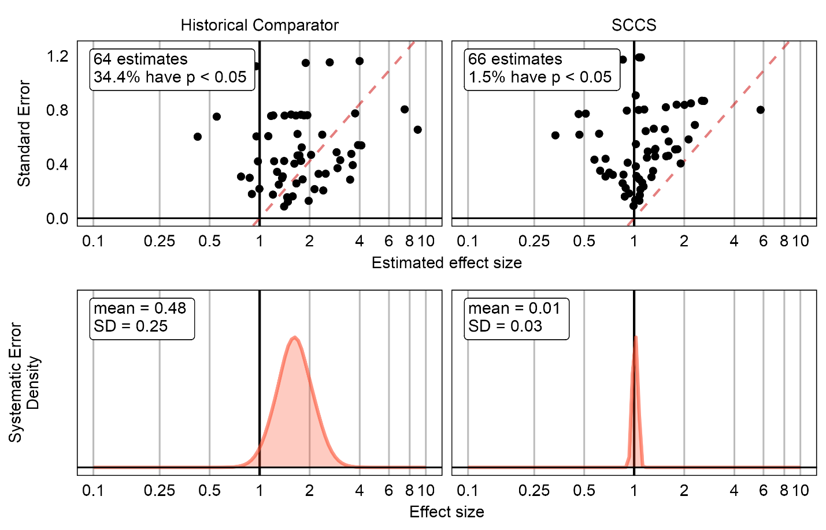
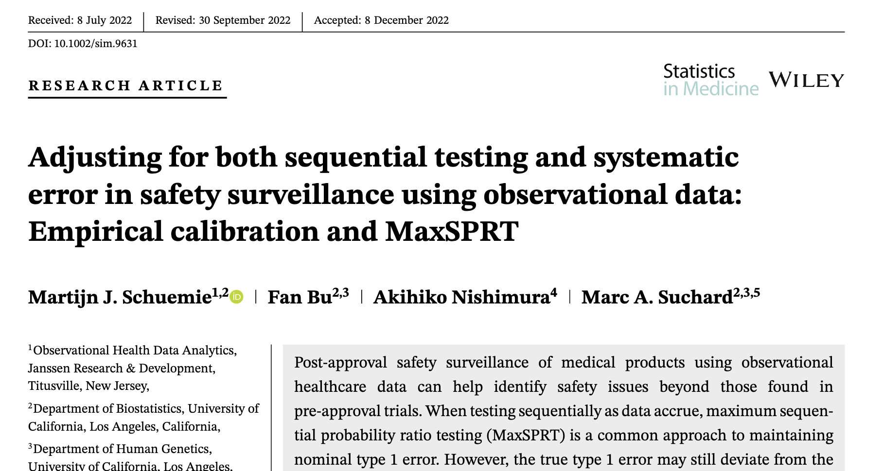
Quantifying systematic error
Need to execute estimation studies for 66 Target-Outcome combinations.
OHDSI tools readily allow for this (simply swapping out the outcome cohort for the negative controls)

Slide 57
Quantifying systematic error
Expected Absolute Systematic Error (EASE) summarizes this distribution
We use a prespecified EASE threshold (EASE < 0.25) for go – no go decisions for our studies
EASE = 0.49
EASE = 0.04

Slide 58
Combining evidence across a federated network: What to share when estimating causal effects?
Cannot share patient-level data
Usually propensity-score stratified time-to-event or conditional Poisson regression: no 2-by-2 tables
Point-estimates + standard errors?

Slide 59
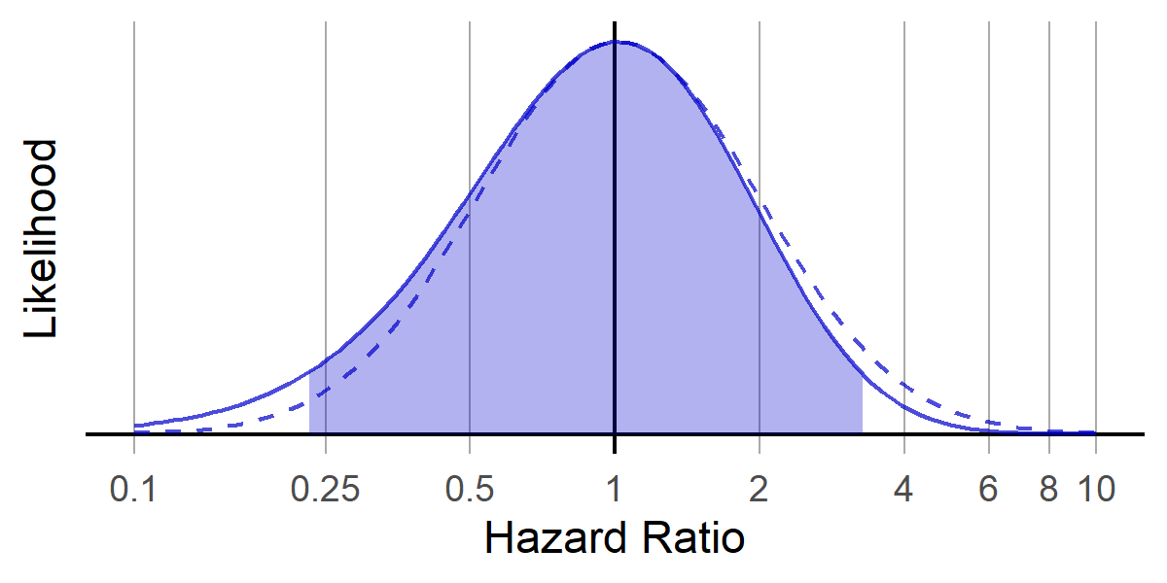
Normal assumption violated when counts are low
Hazard Ratio = 1.02 (0.27 – 3.78)
Hazard Ratio = 1.02 (0.22 – 3.31)
Assuming normal distribution
No shape assumption
 | Subjects | Outcomes
Target | 22,002 | 3
Comparator | 130,200 | 25
* Real data, no simulation

Slide 60
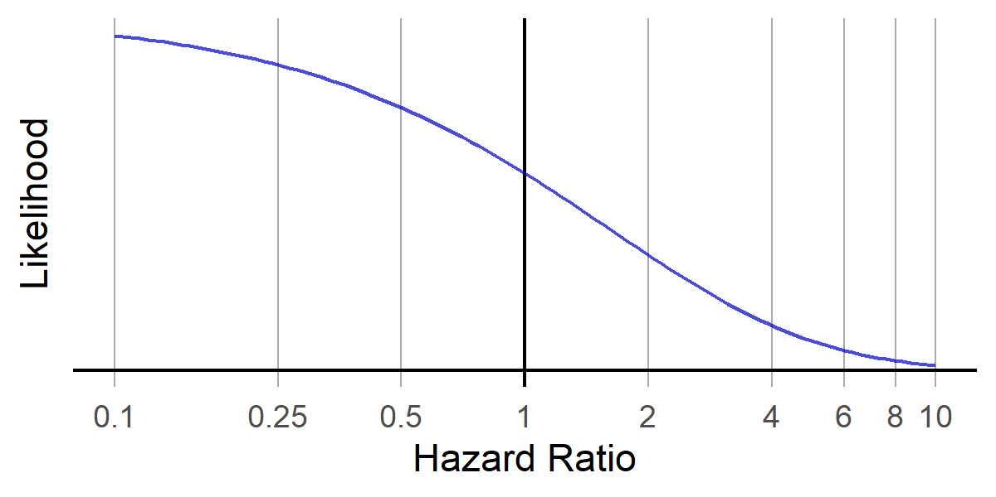
Even more when counts are 0
 | Subjects | Outcomes
Target | 2,834 | 0
Comparator | 15,168 | 10
* Real data, no simulation

Slide 61

Solution
Data sites share actual shape of likelihood, instead of just the hazard ratio + confidence interval

Slide 62
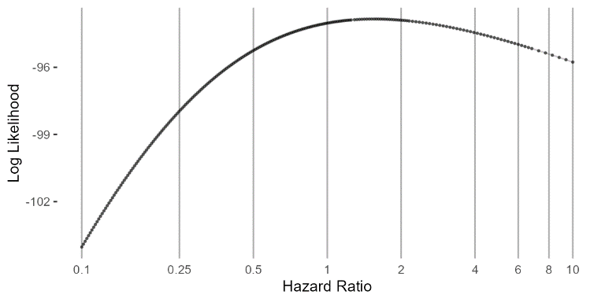
Solution
Data sites share actual shape of likelihood, instead of just the hazard ratio + confidence interval
Current best-practice:
- Adaptive grid

Slide 63
Distributed Research Network
Data sites share shape of likelihood
Study lead
Site A
Site B
CDM
CDM
Site C
Site D
CDM
CDM

Slide 64
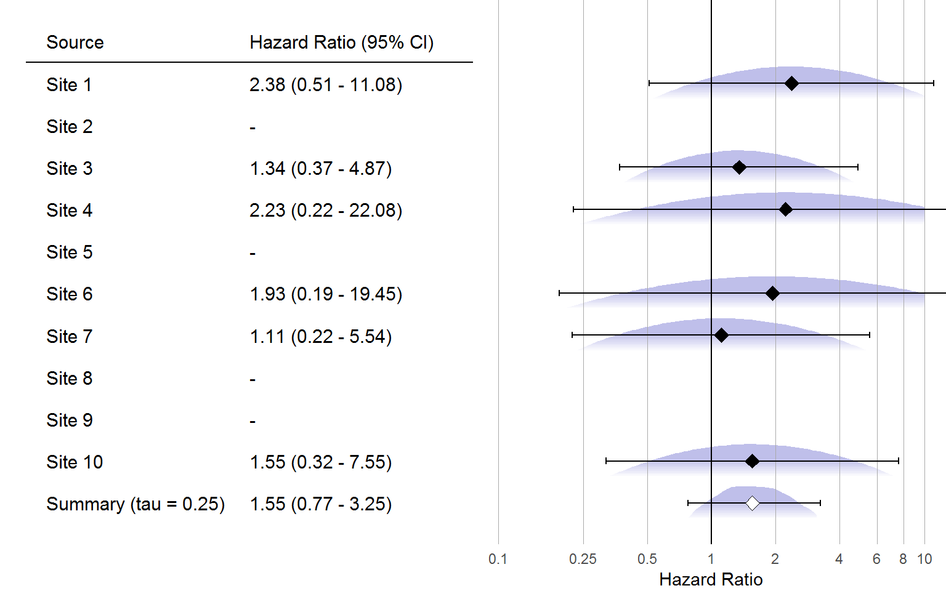
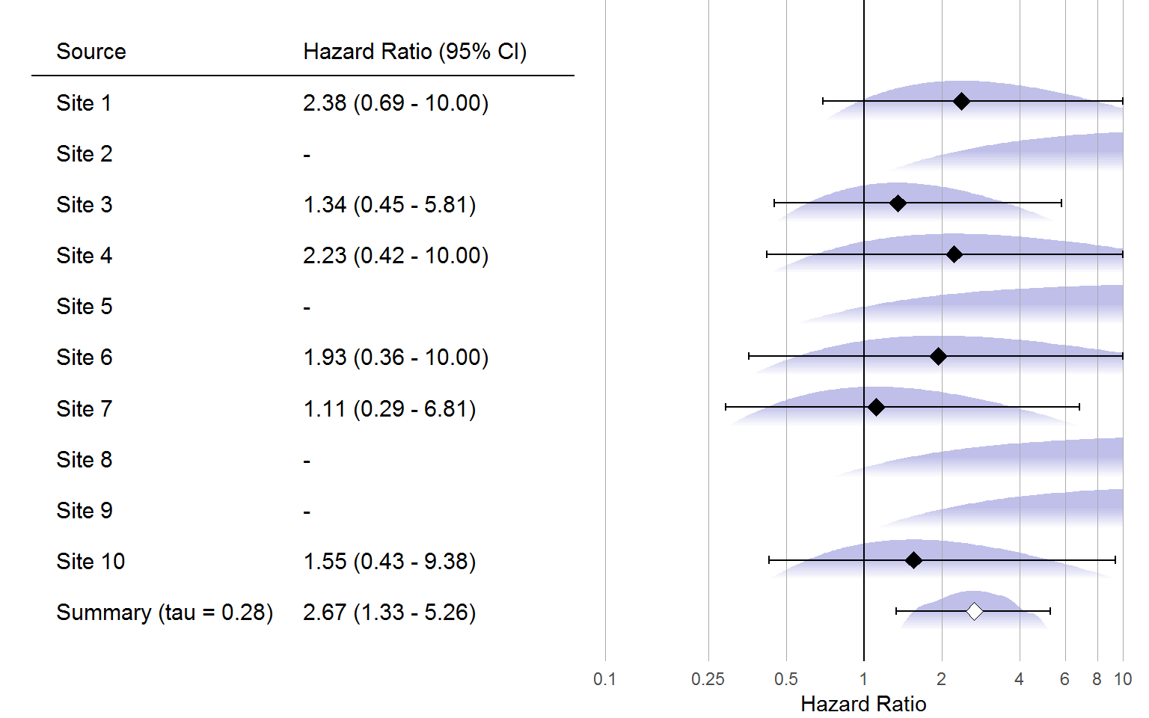
Visualization
Normal approximation
Adaptive grid approximation

Slide 65
Summary

Slide 66
Unique features of HADES analytics
Re-use of cohort definitions
Standardization of analytics in open-source software
Many opportunities for testing, review, fixing bugs, etc.
Making it hard to do the wrong thing (opinionated)
Advanced methods to reduce bias
Splines for time in self-controlled case series
Large-scale propensity scores in cohort method
Objective study diagnostics to improve reliability of evidence
Including negative controls
Designed to run across a network of databases
Without sharing patient-level data

